Slide 1
Object Oriented Programming

Slide 2
Topics To Be Covered Today
Array
Single & Multi-dimensional

Slide 3
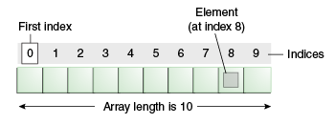
Arrays
An array is a group of liked-typed variables referred to by a common name, with individual variables accessed by their index.
Normally, array is a collection of similar type of elements that have contiguous memory location.
First element of the array is stored at 0 index.
Notes:
an object/data structure that contains elements of similar data type.
Contiguous: next or together in sequence.

Slide 4
Types of Arrays
There are two types of array.
Single Dimensional Array
Multidimensional Array
Arrays are:
1) Declared
2) Created (instantiated)
3) Initialized
4) Used

Slide 5
Array Declaration
Array declaration involves:
1) declaring an array identifier
2) declaring the number of dimensions
3) declaring the data type of the array elements
Three styles of array declaration:
type array-variable[ ];
or
type [ ]array-variable;
or
type[ ] array-variable;
e.g. int abc[ ];
Datatype => int
Identifier => abc
Dimention=> single

Slide 6
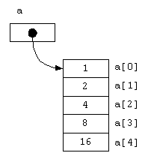
Array Creation
After declaration, no array actually exists.
In order to create an array, we use the new operator:
type array-variable[ ];
array-variable = new type[size];
This creates a new array to hold size elements of type type, whose reference will be kept in the variable array-variable.

Slide 7
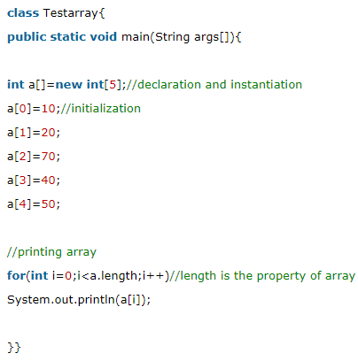
Array Creation

Slide 8
Array Indexing
Later we can refer to the elements of this array through their indexes:
array-variable[index]
The array index always starts with zero!
The Java run-time system makes sure that all array indexes are in the correct range, otherwise raises a run-time error.

Slide 9
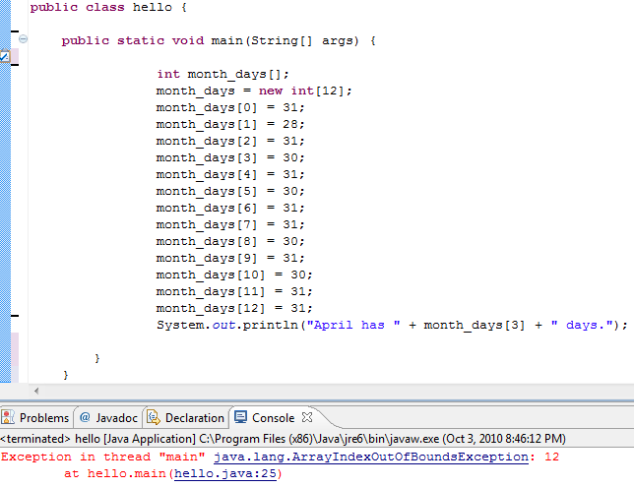

Slide 10
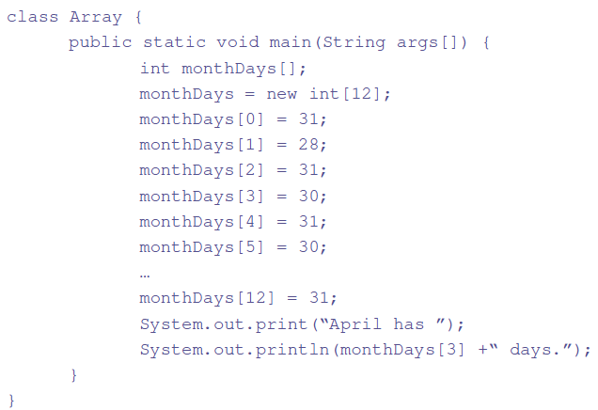
Example: Array Use

Slide 11
Array Initialization
Arrays can be initialized when they are declared:
int monthDays[ ] = {31,28,31,30,31,30,31,31,30,31,30,31};
Comments:
1) there is no need to use the new operator
2) the array is created large enough to hold all specified elements

Slide 12
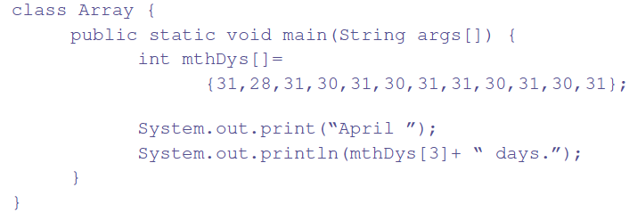
Example: Array Initialization

Slide 13
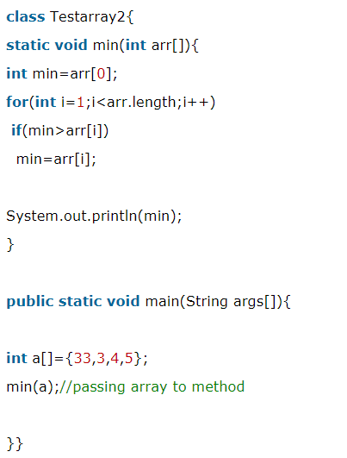
Passing Array to method in java

Slide 14
Multi-dimensional Array
Multidimensional arrays are arrays of arrays:
1) declaration
int array[ ][ ];
2) creation
int array[ ][ ] = new int[2][3];
3) initialization
int array[ ][ ] = { {1, 2, 3}, {4, 5, 6} };

Slide 15
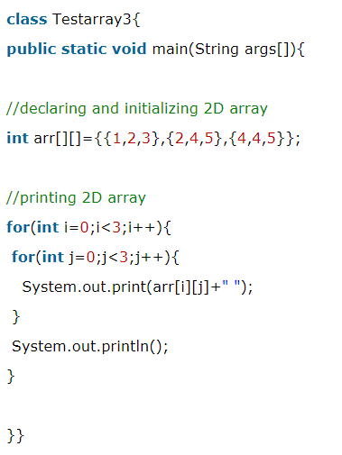
Example: Multi-dimensional Array

Slide 16
class name of java array?
In java, array is an object.
For array object, a proxy class is created whose name can be obtained by getClass().getName() method on the object.

Slide 17
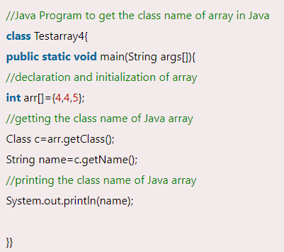
Example
Notes:
String name=arr.getClass().getName();

Slide 18
Copying a java array
An array can be copied to another by the arraycopy() method of System class
Syntax of arraycopy method
arraycopy(Object src, int srcPos,Object dest, int destPos, int length)

Slide 19
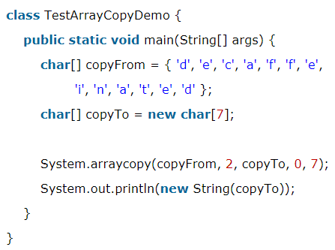
Example
You can use for loop to print dest array:
for(int i=0;i<copyTo.length;i++)
System.out.println(copyTo[i]);

Slide 20
Pros and Cons of Arrays
Advantages
Code Optimization
It makes the code optimized, we can retrieve or sort the data easily.
Random access
We can get any data located at any index position.
Disadvantages
Size Limit
We can store only fixed size of elements in the array. It doesn't grow its size at runtime.

Slide 21
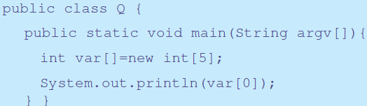
Class Participation

Slide 22
Questions?

